Slide 1
Simple Notification Service(SNS) Using Spring Boot

Slide 2
What is Amazon SNS?
Amazon Simple Notification Service (SNS) is a service that enables a publisher to send notifications on a specific topic to its consumers (i.e. receivers) through various communication channels like SMS, Email, HTTP, HTTPS, AWS SQS, and AWS Lambda.
It supports over 200+ countries for SMS and Email notifications
Guarantees message delivery as long as the SMS or the Email address is valid
AWS provides excellent and well-written SNS SDK for Java language

Slide 3
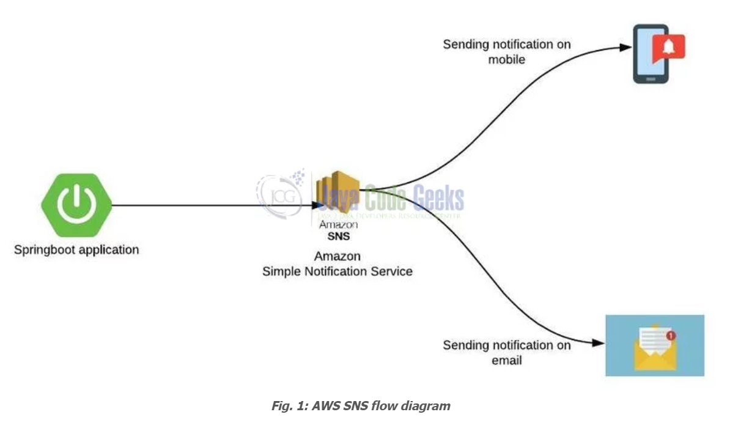

Slide 4
SNS mobile notification Example
You need to create a Standard SNS topic and subscribe to it. For this sign in to the AWS console with your credentials and navigate to the SNS console. Once you land onto the SNS page click on the Create topic button and something like below will be shown

Slide 5
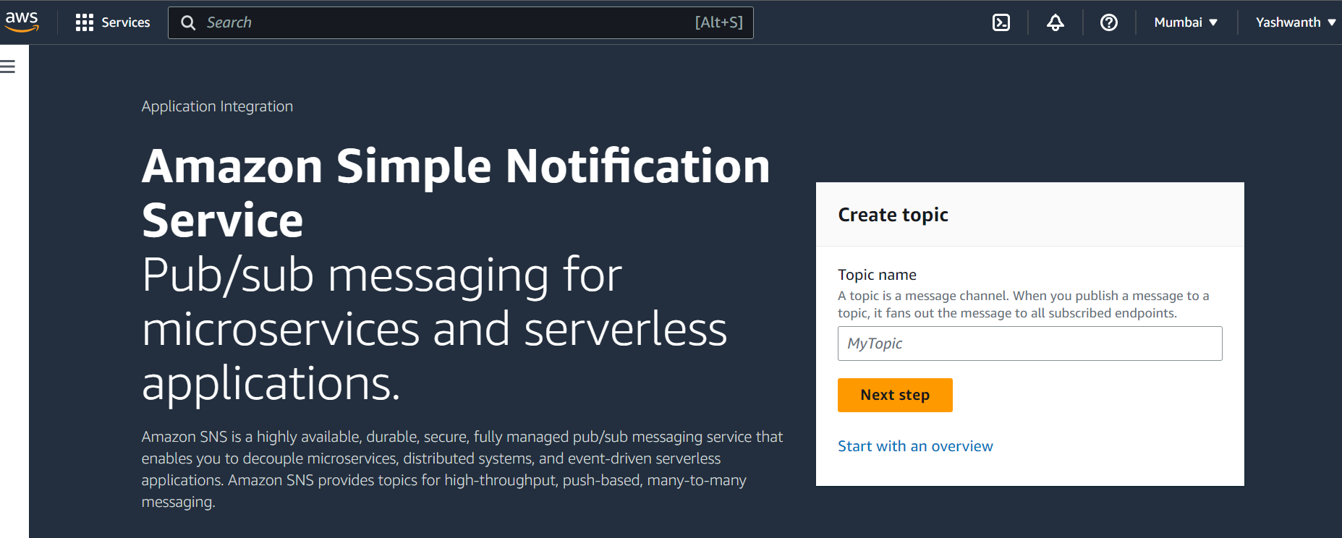

Slide 6
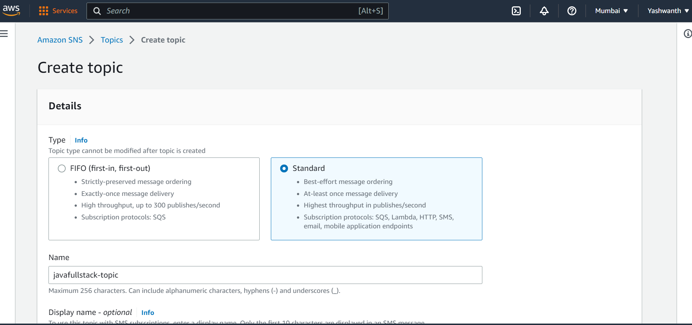

Slide 7
Fill in the topic name and select the Standard topic radio button and leave the rest details as default. Submit the form and on the successful creation of the topic, you will get a green toaster saying topic created successfully. Once the topic is created remember to store the ARN (Amazon Resource Name) as we’ll need it later. Create a subscription using the Create subscription button. Select the protocol as Email and fill in the endpoint as a Email id (i.e. Subscriber emailid) to which you would like to subscribe. The subscriber will be automatically confirmed if the protocol is selected as Email.

Slide 8
Simple Queue Service(SQS) Using Spring Boot

Slide 9
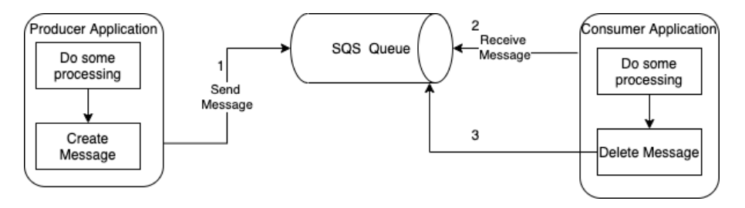
What is SQS?
Basically Amazon SQS is a distributed messaging system for point-to-point communication and is offered as a fully managed service in the AWS Cloud.
It follows the familiar messaging semantics of a producer sending a message to a queue and a consumer reading this message from the queue once the message is available as shown here

Slide 10
Producers can send messages to a queue. The queue will receive those messages and will keep them in the queue until a consumer will poll the queue and will process the message. There can be more than one consumer of course. This is in simple words what a queue can do for you. This way, you have decoupled the producing applications from the consuming applications which is a quite nice integration pattern. Besides that, the queue can store the messages when there would be a burst of messages produced by the producers. The consumers can consume the messages at their own pace.

Slide 11
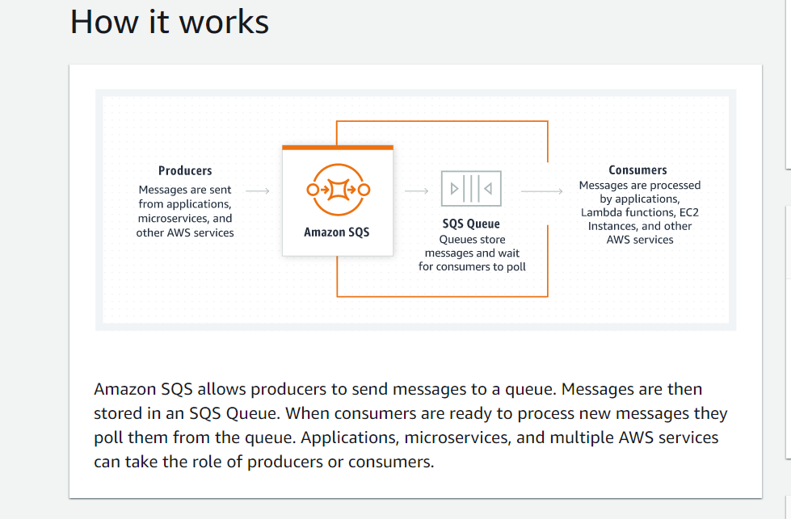

Slide 12
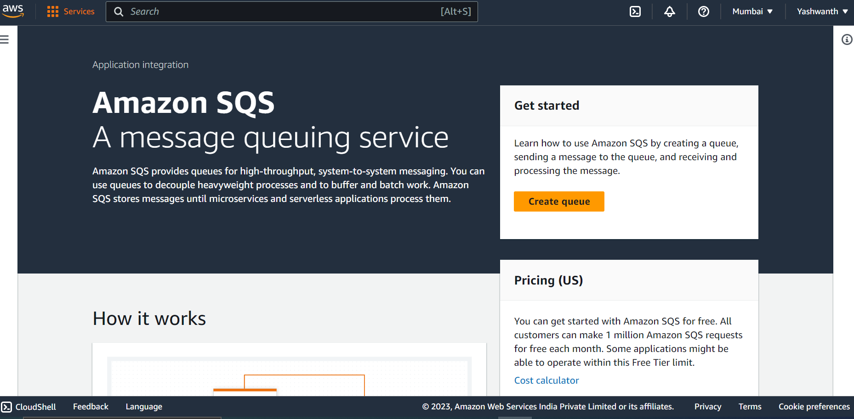

Slide 13
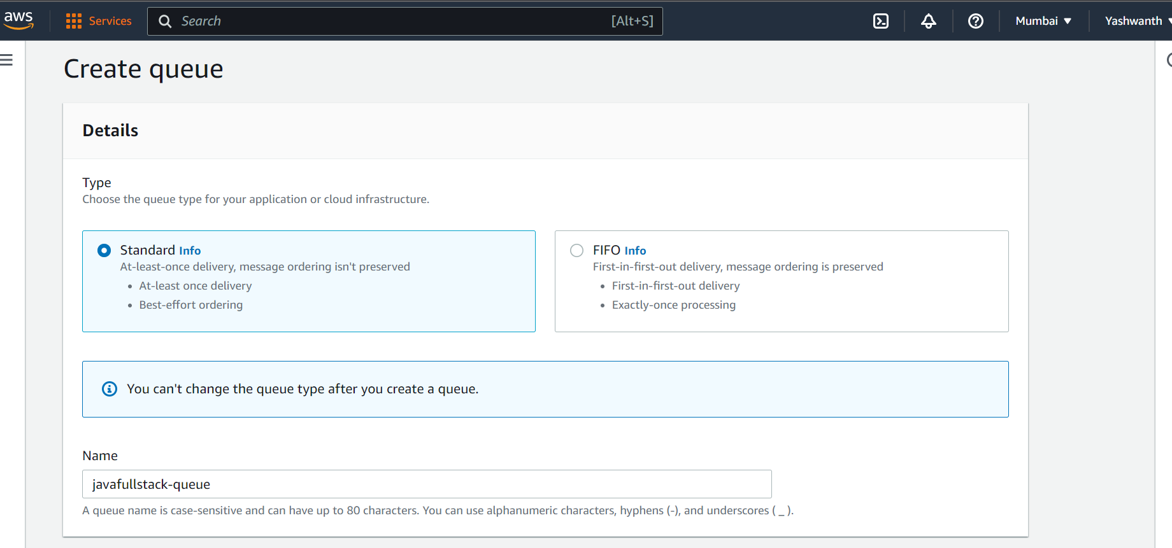

Slide 14
References
https://github.com/Yashwanth-Ravula1025/Spring-Cloud-AWS-SQS-and-SNS

